Slide 1

The Process of Interaction Design

Slide 2

Overview
What is Interaction Design?
  Four basic activities
  Three key characteristics
Some practical issues
  Who are the users?
  What are ‘needs’?
  Where do alternatives come from?
  How do you choose among alternatives?
Lifecycle models from software engineering
Lifecycle models from HCI

Slide 3
What is Interaction Design?
It is a process:
  a goal-directed problem solving activity informed by intended use, target domain, materials, cost, and feasibility
  a creative activity
  a decision-making activity to balance trade-offs
It is a representation:
  a plan for development
  a set of alternatives and successive elaborations

Slide 4
Four basic activities
There are four basic activities in Interaction Design:
  Identifying needs and establishing requirements
  2. Developing alternative designs
  3. Building interactive versions of the designs
  4. Evaluating designs

Slide 5
Three key characteristics
Three key characteristics permeate these four activities:
  1. Focus on users early in the design and evaluation of the artefact
  2. Identify, document and agree specific usability and user experience goals
  3. Iteration is inevitable. Designers never get it right first time

Slide 6
Some practical issues
Who are the users?
What are ‘needs’?
Where do alternatives come from?
How do you choose among alternatives?

Slide 7
Who are the users/stakeholders?
Not as obvious as you think:
  those who interact directly with the product
  those who manage direct users
  those who receive output from the product
  those who make the purchasing decision
  those who use competitor’s products
Three categories of user (Eason, 1987):
  primary: frequent hands-on
  secondary: occasional or via someone else
  tertiary: affected by its introduction, or will influence its purchase
Notes:
Text book page17
User centered design CH4 page 48

Slide 8
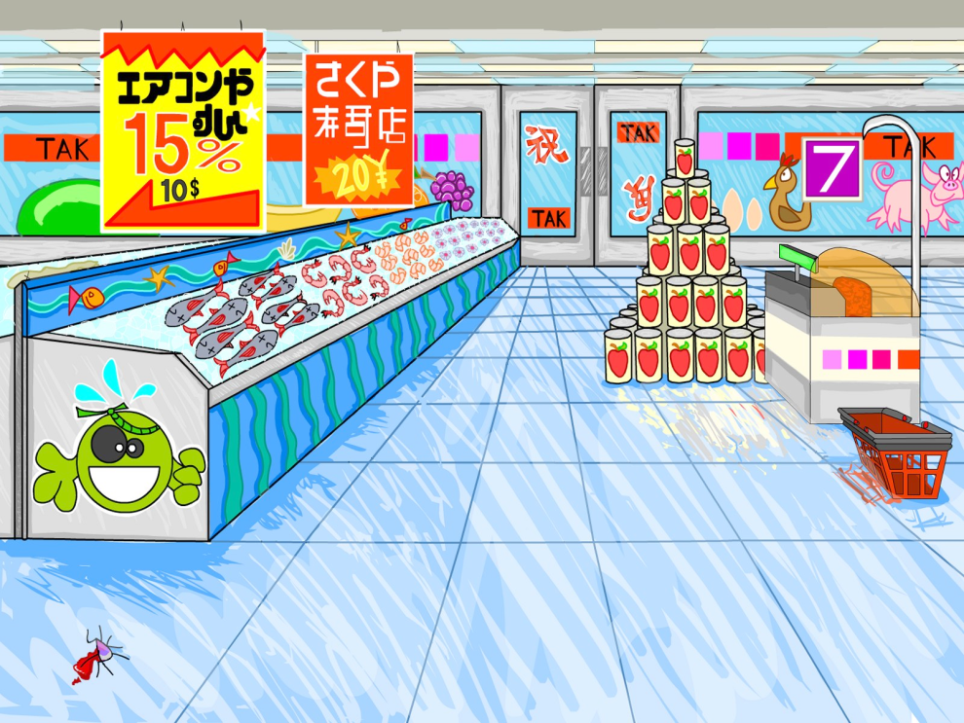
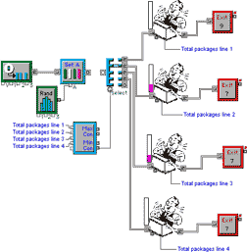
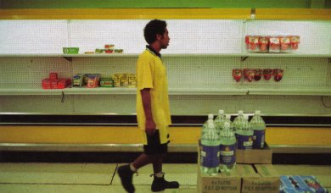
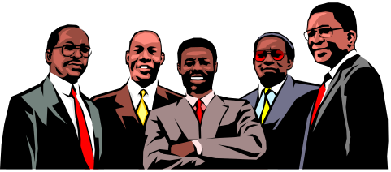
Who are the stakeholders?
Check-out operators
• Suppliers
• Local shop
owners
Customers
Managers and owners

Slide 9


What are the users’ capabilities?
Humans vary in many dimensions:
  size of hands may affect the size and positioning of input buttons
  motor abilities may affect the suitability of certain input and output devices
  height if designing a physical kiosk
  strength - a child’s toy requires little strength to operate, but greater strength to change batteries
  disabilities(e.g. sight, hearing, dexterity)

Slide 10
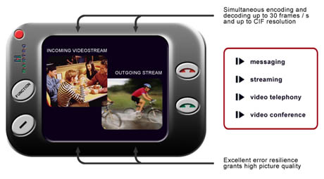
What are ‘needs’?
Users rarely know what is possible
Users can’t tell you what they ‘need’ to help them achieve their goals
Instead, look at existing tasks:
  their context
  what information do they require?
  who collaborates to achieve the task?
  why is the task achieved the way it is?
Envisioned tasks:
  can be rooted in existing behaviour
  can be described as future scenarios

Slide 11
Where do alternatives come from?
Humans stick to what they know works
But considering alternatives is important to ‘break out of the box’
Designers are trained to consider alternatives, software people generally are not
How do you generate alternatives?
  ‘Flair and creativity’: research and synthesis
  Seek inspiration: look at similar products or look at very different products

Slide 12
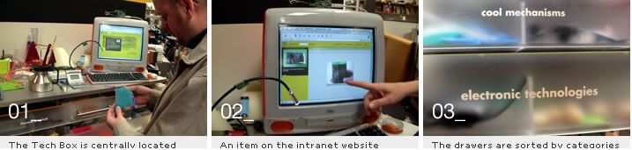
IDEO TechBox
Library, database, website - all-in-one
Contains physical gizmos for inspiration
From: www.ideo.com/

Slide 13
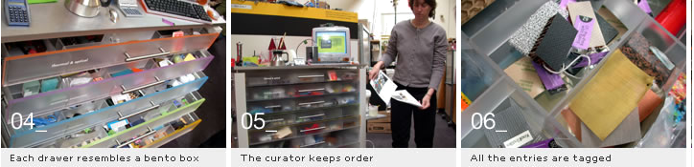
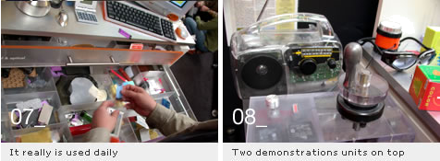
The TechBox

Slide 14
How do you choose among alternatives?
Evaluation with users or with peers, e.g. prototypes
Technical feasibility: some not possible
Quality thresholds: Usability goals lead to usability criteria set early on and check regularly
    safety: how safe?
    utility: which functions are superfluous?
    effectiveness: appropriate support? task coverage, information available
    efficiency: performance measurements

Slide 15
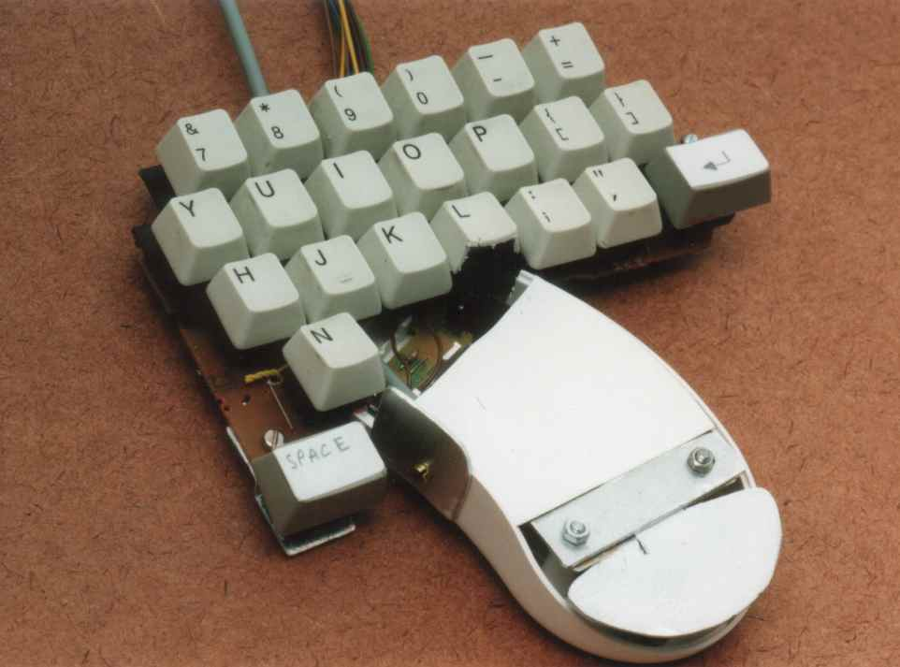
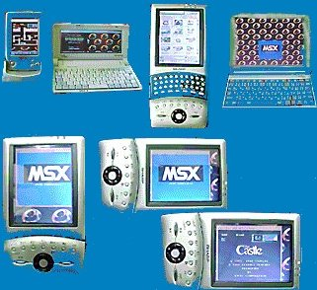
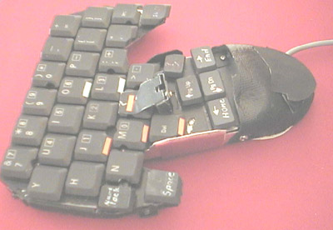
Testing prototypes to choose among alternatives

Slide 16
Lifecycle models
Show how activities are related to each other
Lifecycle models are:
  management tools
  simplified versions of reality
Many lifecycle models exist, for example:
  from software engineering: waterfall, spiral, JAD/RAD, Microsoft
  from HCI: Star, usability engineering

Slide 17
A simple interaction design model
Identify needs/
establish
requirements
(Re)Design
Evaluate
Build an
interactive
version
Final product
Exemplifies a user-centered design approach

Slide 18
Traditional ‘waterfall’ lifecycle
Requirements
analysis
Design
Code
Test
Maintenance
Notes:
Familiarity paradox
The person who is the most familar with the system is the least appropriate person to evaluate it

Slide 19
A Lifecycle for RAD
(Rapid Applications
Development)
Project set-up
JAD workshops
Iterative design and build
Engineer and
test final prototype
Implementation
review

Slide 20
Spiral model (Barry Boehm)
Important features:
  Risk analysis
  Prototyping
  Iterative framework allowing ideas to be checked and evaluated
  Explicitly encourages alternatives to be considered
Good for large and complex projects but not simple ones

Slide 21
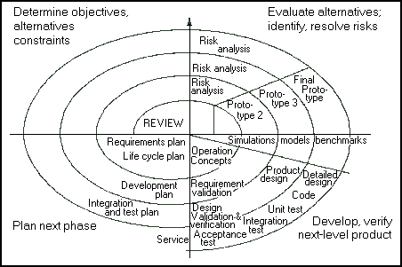
Spiral Lifecycle model
From cctr.umkc.edu/~kennethjuwng/spiral.htm

Slide 22
The Star lifecycle model
Suggested by Hartson and Hix (1989)
Important features:
  Evaluation at the center of activities
  No particular ordering of activities. Development may start in any one
  Derived from empirical studies of interface designers

Slide 23
The Star Model (Hartson and Hix, 1989)
Implementation
task/functional
analysis
Prototyping
Evaluation
Requirements
specification
Conceptual/
formal design
Notes:
UCD is a very general philosphy that instantiates itself in the context of a design project. Within HCI there have been many attempts to come up with actual life cycles where users are central. Examples include Rubinstein and Hersch successive iteration of 5 stages, info collecion, design, implementation, evaluation and deploment. The one here is taken fromHartson and Hix
model came about by analysing how design takes place in practice
evaluation is central: results of each ativity are evaluated before going onto next one
both bottom-up and top -down required in waves
software designers are familiar with this in their work and call it ‘yo-yoing’
it is important to do both structure and detail at the same time
in practice this is what is done - but the end result suggests otherwise corporate requirments dictate a top=down approach which is wha gets recorded
ch 5 of Developing User Interfaces (An Overview of Systems Analysis and Design) p- nice step-by-step methodology for doing user-centred design

Slide 24
Usability engineering lifecycle model
Reported by Deborah Mayhew
Important features:
  Holistic view of usability engineering
  Provides links to software engineering approaches, e.g. OOSE
  Stages of identifying requirements, designing, evaluating, prototyping
  Can be scaled down for small projects
  Uses a style guide to capture a set of usability goals

Slide 25
Summary
  Four basic activities in the design process
    Identify needs and establish requirements
    Design potential solutions ((re)-design)
    Choose between alternatives (evaluate)
    Build the artefact
  These are permeated with three principles
    Involve users early in the design and evaluation of the artefact
    Define quantifiable & measurable usability criteria
    Iteration is inevitable
  Lifecycle models show how these are related

